Slide 1
Develop Great Universal Windows Platform User Experiences (Lifecycle)
Danny Warren
@dannydwarren (GitHub, Twitter, LinkedIn)
dannydwarren@gmail.com

Slide 2













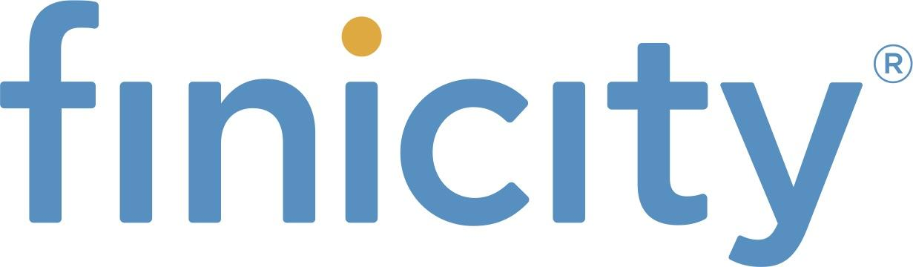
Thanks to our Sponsors!
Partners
Premier
Marquee:
Prize:

Slide 3

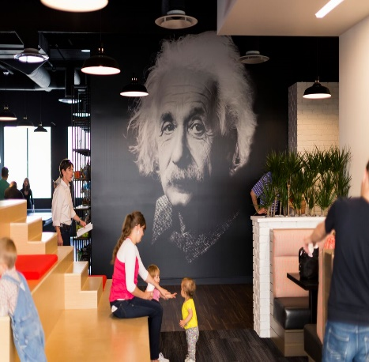
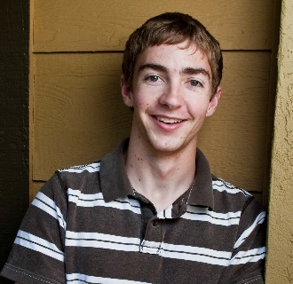
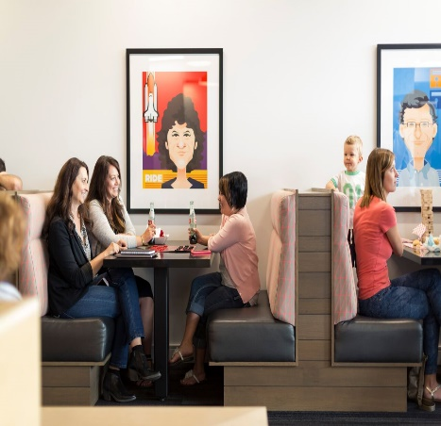
Mission: Creating progress through technology that lifts the human condition.
Software Craftsmanship: TDD, Pair programming, Lean, Autonomous & Responsible Teams
Continual Improvement: This is why I can be here with you!
DANNY WARREN, SOFTWARE CRAFTSMAN
Neumont University 2009, B.S. C.S.
8 Years Custom Application Development/ Built NUI solutions:
Xamarin, UWP, WPF, Azure
Touch, Gestures, Speech, & Mouse and Keyboard
Microsoft MVP Alumnus in Windows Platform Development (Oct 2013 – 2015)
Avid Mt. Biker and aspiring Rock Climber
Notes:
Cultural Ambassador
Compliance

Slide 4

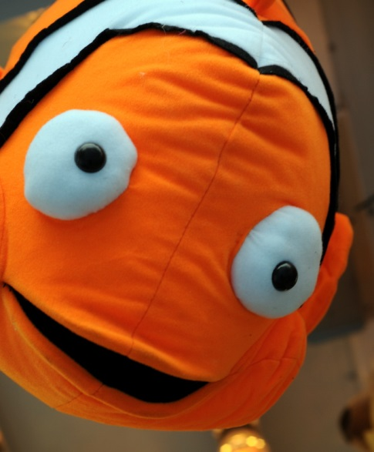
App Lifecycle
Invisible but EXTREMELY important!
Affects
UX
Data
Possible Facial Side Effects
MAD
HAPPY

Slide 5
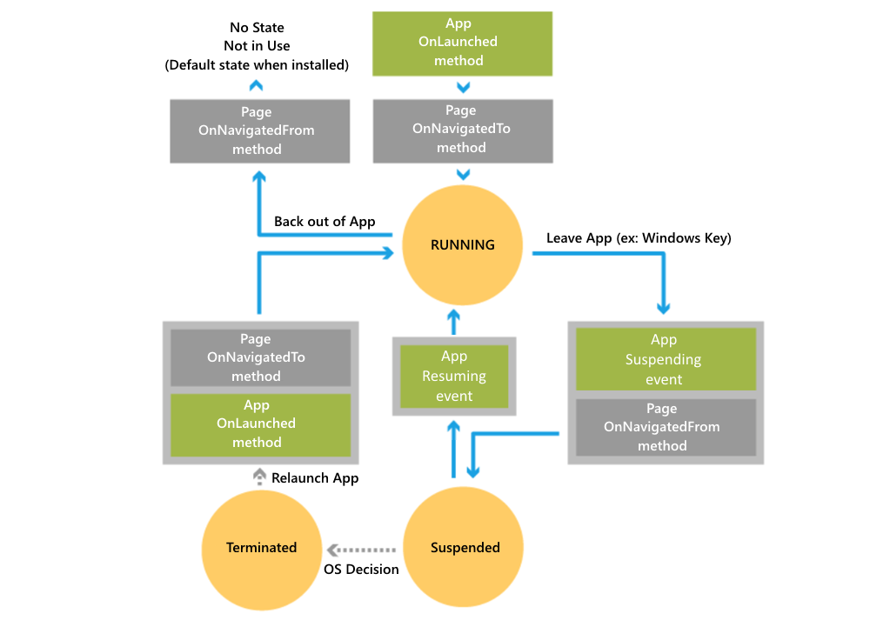

Slide 6
Download Materials
Blog: https://dannydwarren.github.io
GitHub Repo (Materials):
http://github.com/dannydwarren/CrawlWalkTalk
Interested in talking more?
Reach out and mention this session!
dannydwarren@gmail.com
@dannydwarren (Twitter/LinkedIn/GitHub)

